Slide 1
Monthly Office Hours April 9th, 2025

Slide 2
Market Update with Andrew Almeida
Review Model Changes
Performance of Indices
Equity Market Review
Fixed Income Market Review
Outlook & Opportunity

Slide 3
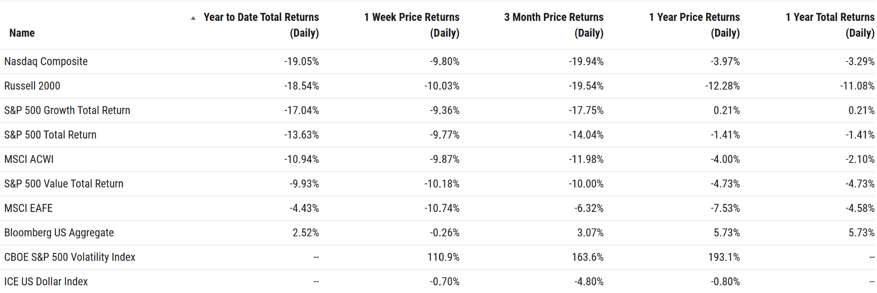
Indices

Slide 4
Recap Model Updates
EQUITY
Increase US exposure to 60% across all models
Reduce International exposure to 40%
“Core”, “DFA”, “Cause” all include 5% Global RE as part of 40% International
https://support.xyinvestmentsolutions.com/article/224-model-due-diligence-kit

Slide 5
Recap Model Updates
Fixed Income - Unchanged
Vanguard Intermediate Corp VCIT 30.0%
SPDR Intermediate Treasury SPTI 20.0%
Vanguard Total International Bond BNDX 30.0%
Vanguard ST Corporate Bond VCSH 10.0%
Vanguard ST Inflation Protection VTIP 10.0%
Weighted Avg Dist. 4.07%, Effective Duration 5.44 (As of 4/8/2025 per Ycharts Data)

Slide 6
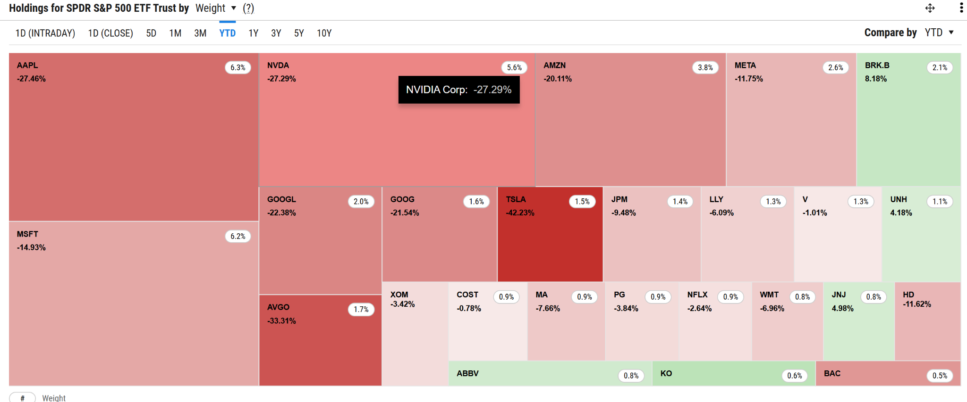
US Equities - YTD Performance

Slide 7
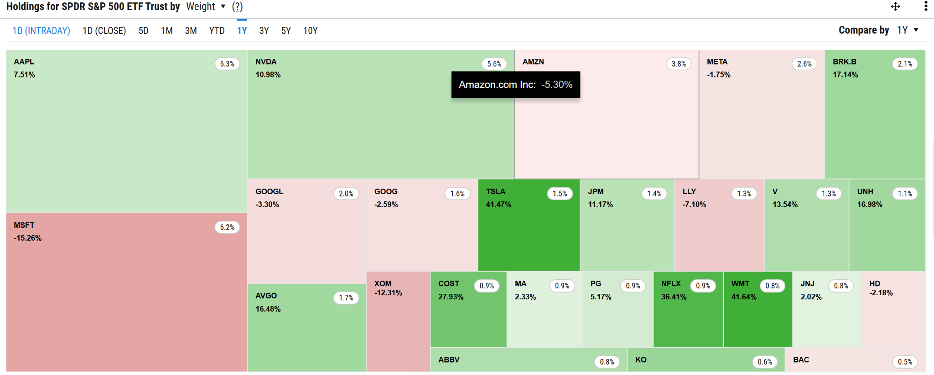
US Equities - 1 Year Performance

Slide 8
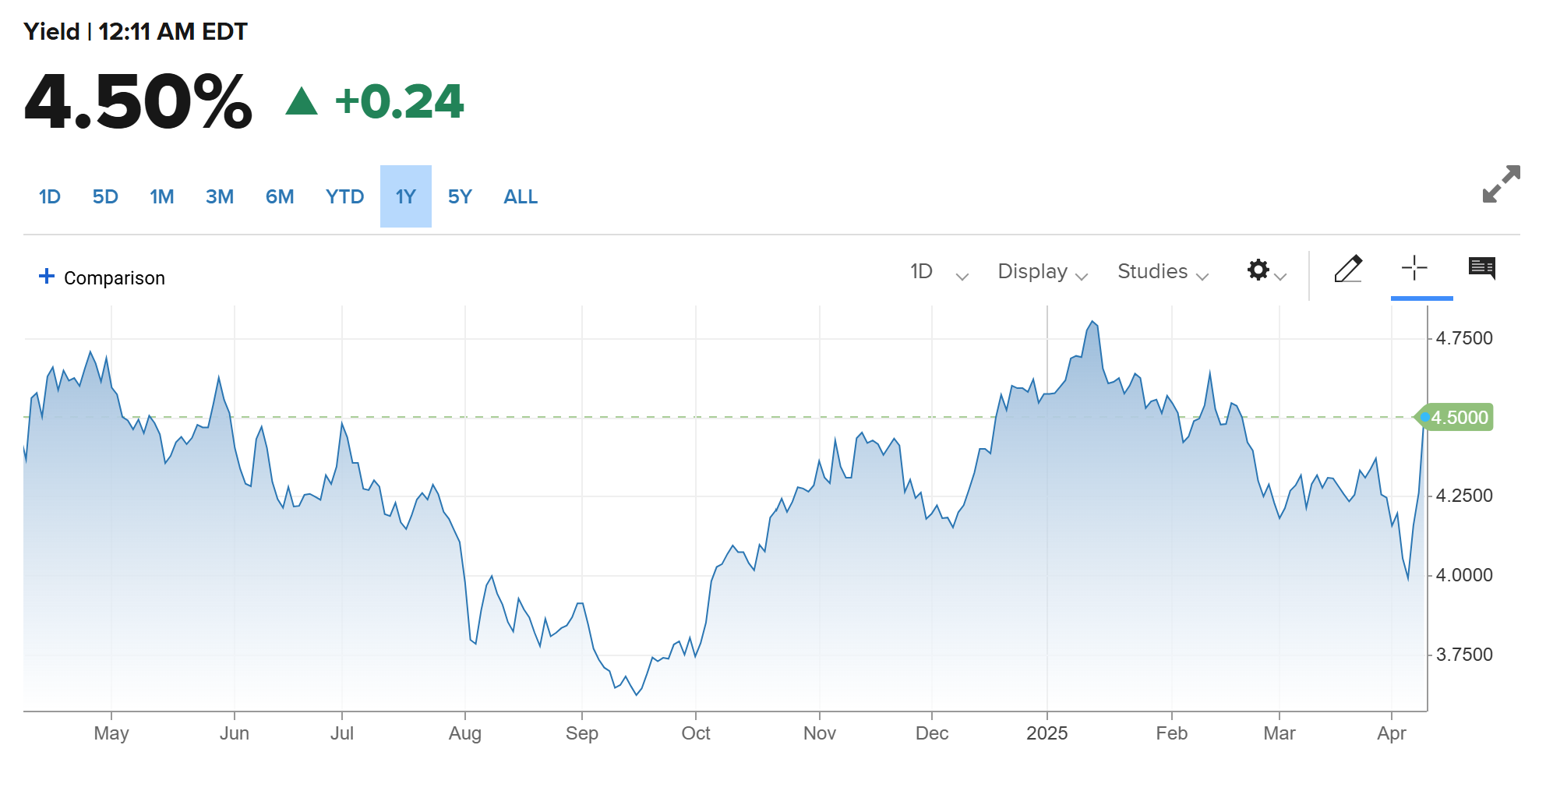
Interest Rate Volatility

Slide 9
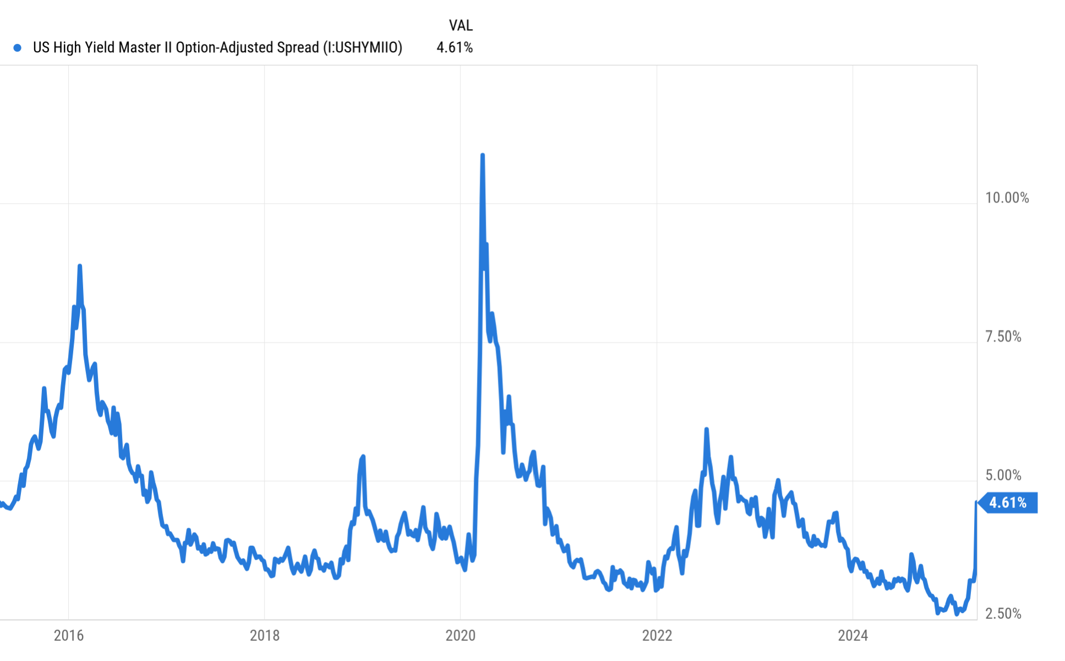
Credit Spreads Widening

Slide 10
Outlook & Opportunity
Outlook - continued volatility from policy changes, inflation, trade imbalances, geopolitical risk. Interest Rate Uncertainty
Opportunity - in areas with more certainty
US Value (SMID, Buybacks, US Centric MOATs)
US Fixed Income
If we have a credit event - then post spread adjustment (Credit Repricing) we may begin to look at High Yield FI

Slide 11
Next-Level Digital
We will be leaning into Schwab’s digital tools in the coming months. These include e-Authorization and Digital Onboarding. More updates coming soon!
Here are a just a few of the benefits of Schwab’s Digital Tools:
Reducing Manual Entry
Reducing NIGO’s
Faster processing time
Enhanced security (clients complete these workflows in-app)

Slide 12
Get ready for digital workflows:
The most important thing YOU can do to get ready for digital workflows is to make sure your clients have access to Schwab Alliance.
In Schwab, click on the accounts tab, then click on your firm name in the left-hand menu to ensure you’re viewing ALL accounts
In the top-right of the table, click on columns and make sure “web access” is selected.
Review any clients that are marked “No”

Slide 13
Get ready for digital workflows:
Learn more here! https://sac.schwabinstitutional.com/SI2/ASK/Content/secure/ask/servicing-accounts/maintaining-accounts/account-changes/intro-to-DO-and-account-maintenance-eAuth.html

Slide 14
ADV Delivery Reminder: Deliver updated disclosures to clients by 4/30
See our updated disclosures here
Sign the attestation here

Slide 15
Growth Award Winner
Our growth award winner is Jon Butler, CFP® of Opulence Planning in Montana. Jon had the highest Net New Assets in March. Congrats!

Slide 16
Important Dates
Quarterly Market Review with Mario Nardone
April 15th, 2025 | 9 AM Pacific / 12 PM Eastern (Register HERE)
1
Good Friday - Markets Closed / Office Closed
April 18th, 2025
2
XYPN Retreat
April 29th-May 1st
3

Slide 17
Questions?
Reach our team via email: support@xyinvestmentsolutions.com

Slide 18
Disclosures
This information is not intended to be used as the primary basis for investment decisions, nor should it be construed as advice designed to meet the particular needs of an individual investor. Investing in mutual funds, ETFs, and other equity and debt securities involves risk, including loss of principal. An investor should consider a portfolio’s investment objectives, risks, and expenses carefully before investing. Please read any applicable funds’ prospectus carefully before investing. Investors cannot invest directly in an index. Indexes are unmanaged and reflect reinvested dividends and/or distributions, but do not reflect sales charges, commissions, expenses or taxes.
XYPN Invest constructs and manages investment models (“Model Portfolios”) through a technology solution. The Model Portfolios can be used by investment adviser representatives (“IARs”) of XYPN Invest, an SEC registered investment adviser (“RIA”), as well as IARs of other unaffiliated RIAs (“iIARs”). iIARs are members of XYPN, but not affiliated with the XYPN Invest RIA. XYPN Invest manages its Model Portfolios on a discretionary basis primarily by allocating assets among various mutual funds and exchange-traded funds (“ETFs”). XYPN Invest may allocate to individual securities in certain circumstances. IARs and iIARs are ultimately responsible for choosing the appropriate Model and overall allocations for their Clients.

